Slide 1
Defining Big-θ Mathematically

Slide 2
Big-O Definition
Given a function f: ℝ → ℝ and a function g: ℝ → ℝ, f is O(g) if there exists a constant c > 0 and a minimum size n₀ such that:
Notes:
Here’s the mathematical definition of Big O. function f is the potentially complicated function we get by counting steps. g is the big O class. to say that f is O(g) means that we can multiply g by some constant c, and it will eventually be bigger. In math, there is a minimum size, n_0, and if n is bigger than this, then g is bigger.
Another way to think of this is that g is an upper bound on f, at least after you multiple by c and increase n enough.

Slide 3
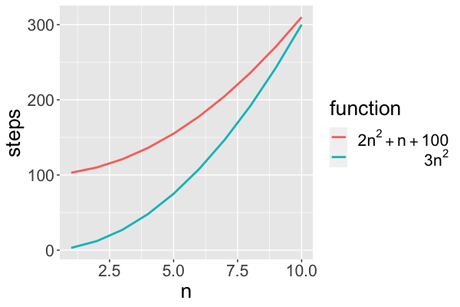
Big-O Example
f(n) = 2n² + n + 100
g(n) = n²
c = 3
Notes:
Let’s see this work with our example. Our f is 2n^2 + n + 100, our g is n^2. We have to multiply g by something, we’ll choose 3. (anything bigger than 2 will work).
Here’s a graph of f in red, and 3n^2 in blue. and you can see that our function f is bigger… but that’s because we’re looking at sizes that are too small. If we keep increasing n, remember that these lower order terms don’t matter. If you look at the highest order terms, 3n^2 must eventually beat 2n^2.

Slide 4
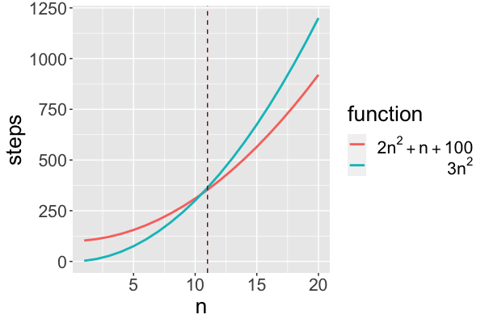
Big-O Example (cont.)
f(n) = 2n² + n + 100
g(n) = n²
c = 3
n₀=11
for n>n₀,
2n² + n + 100 < 3n²
=> f(n) is O(n²)
Notes:
Here’s the same graph extended further to the right.
at n=11, the lines cross. so we can set n_0 to 11, and it turns out that for n to the right of that, 3n^2 is always bigger.
So our function is O(n^2)

Slide 5
Big-O Is an Upper Bound
2n² + n + 100 is O(n²)
… and O(n² log n)
… and O(n³)
… and O(c^{n})
Notes:
Now, I want to make a technical point. remember that I said that big O is an upper bound. That means there are actually other functions we could have chosen.
O(n^2 log n)...
even e^n!
I called this a technical point, because it’s something that a lot of people don’t recognize, at least people that aren’t theoretical computer scientists.
Of course, these other classes are not very informative. we really want a way to say, which is the smallest Big O bound.

Slide 6
Big-Ω Is a Lower Bound
Given a function f: ℝ → ℝ and a function g: ℝ → ℝ, f is Ω(g) if there exists a constant c > 0 and a minimum size n₀ such that:
Notes:
We’ll get there in two steps. First, I want to show you the related definition of Big Omega. The definition looks almost exactly the same. The only change is that we switch the less than for a greater than. So g is now a lower bound instead of an upper bound. To say a funciton is Omega of g, is to say it’s bigger than g - at least if you multiply by a constant and look at large n.

Slide 7
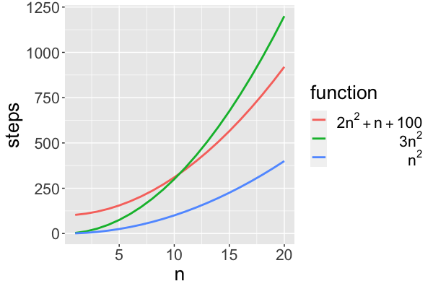
Big-Ω Example
f(n) = 2n² + n + 100
g(n) = n²
c = 1
n₀= 0
For any n>n₀,
2n² + n + 100 > n²
=> f is Ω(n²)
Notes:
Here’s an example of big theta in action. This funciton is Big theta of n^2, which means that we need both an upper and lower bound the upper bound is the same as before. for the lower bound, we can use n^2, which is always smaller than the function.
You can think of big theta as the best big-O bound. So it’s really useful, because it divides algorithms into separate classes.

Slide 8
Big-θ Definition
Given a function f: ℝ → ℝ and a function g: ℝ → ℝ
If f is O(g) and Ω(g), then f is θ(g)
2n² + n + 100 is θ(n²)
Notes:
Finally, what happens when a function works as both an upper and a lower bound?
If a function f is both O(g) and Omega of g, we have a special name for that. We say big Theta.
big theta is a way to say that something is not just a bound on growth rate, it is the exact growth rate. It’s the best possible Big O bound.
Making things confusing, when most people say big O, they really mean Big-Theta. This includes most data scientists. really most people who aren’t theoretical computer scientists. If they ask you for the big O growth rate, you can bet they really mean big theta. We’ll try to be precise and say big Theta in this class, but this is something that you need to remember to avoid possible confusion.

Slide 9
Defining Big-θ Mathematically

